Slide 1
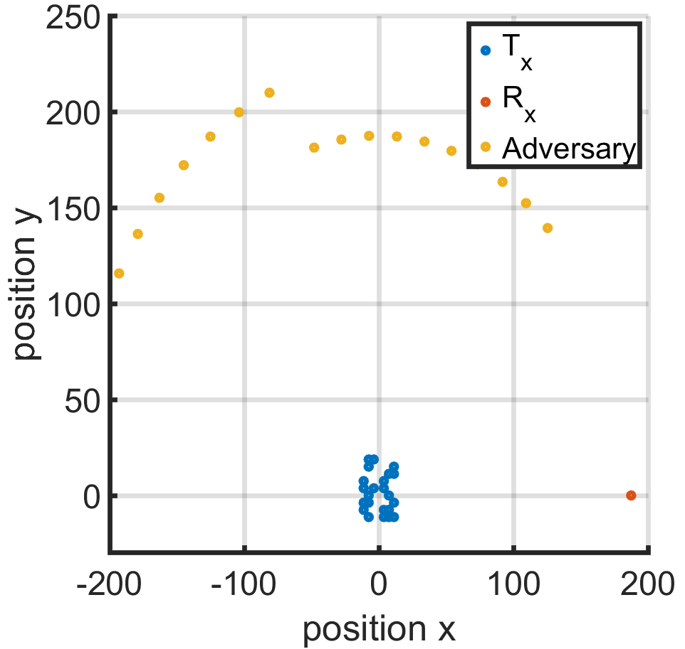
Recreated Kushals Sector based Nullforming IPG Results
22 Tx, 1 allied Rx @ θ = 0, 18 adversaries spaced between π/3 to π

Slide 2
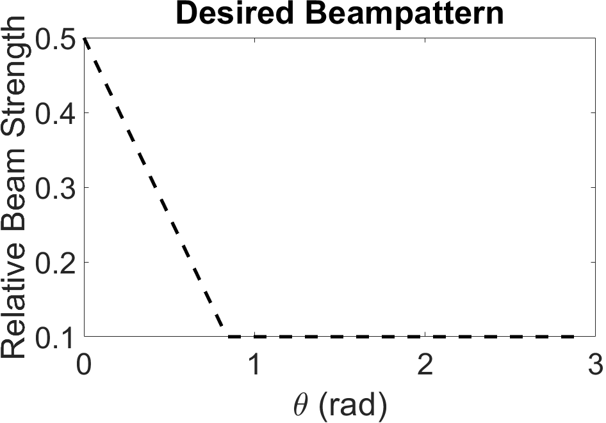
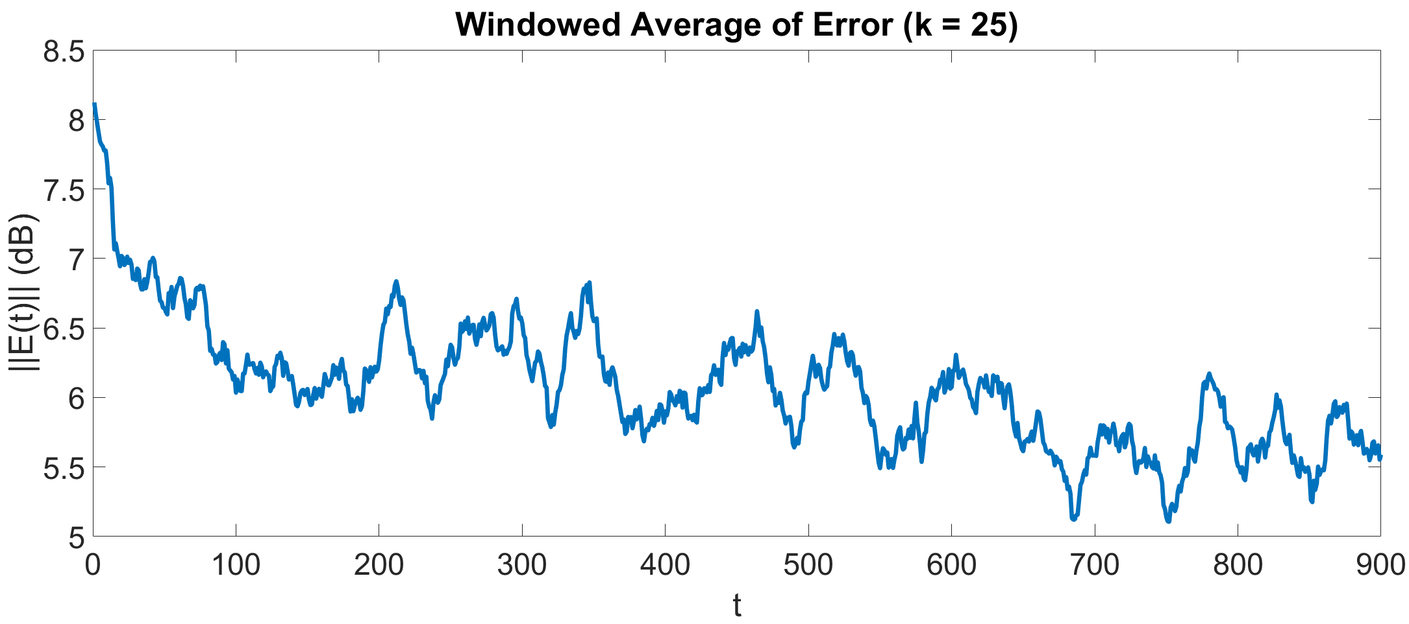
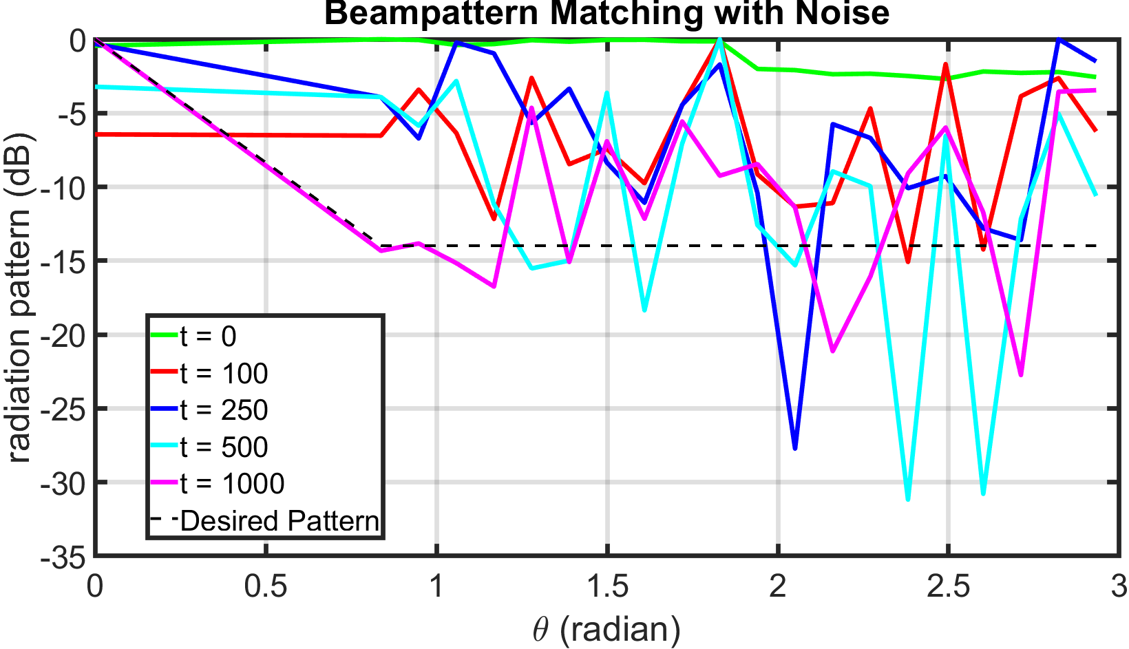
IPG run with flat desired beampattern
Good performance without noise, struggles under noise

Slide 3
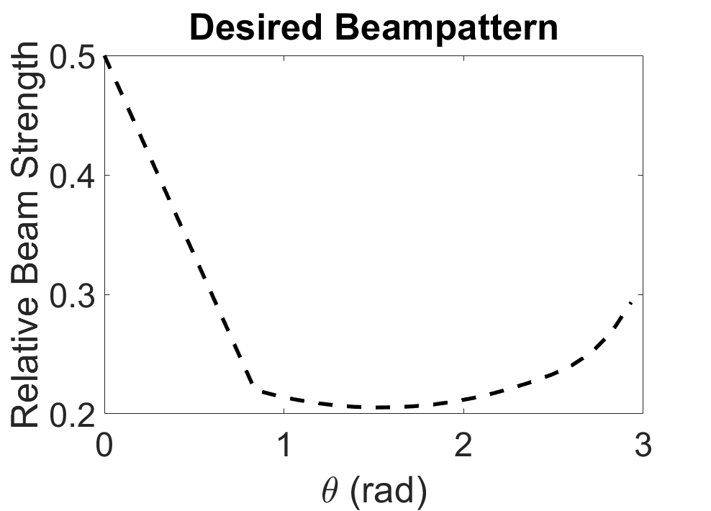
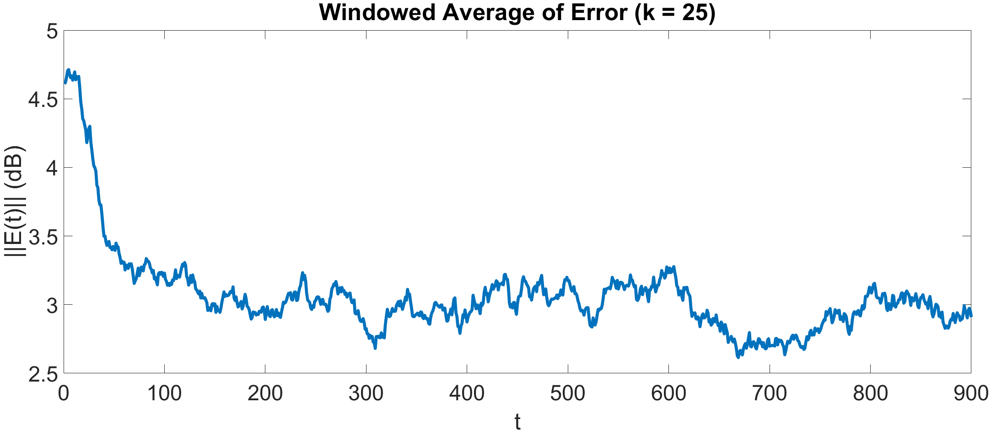
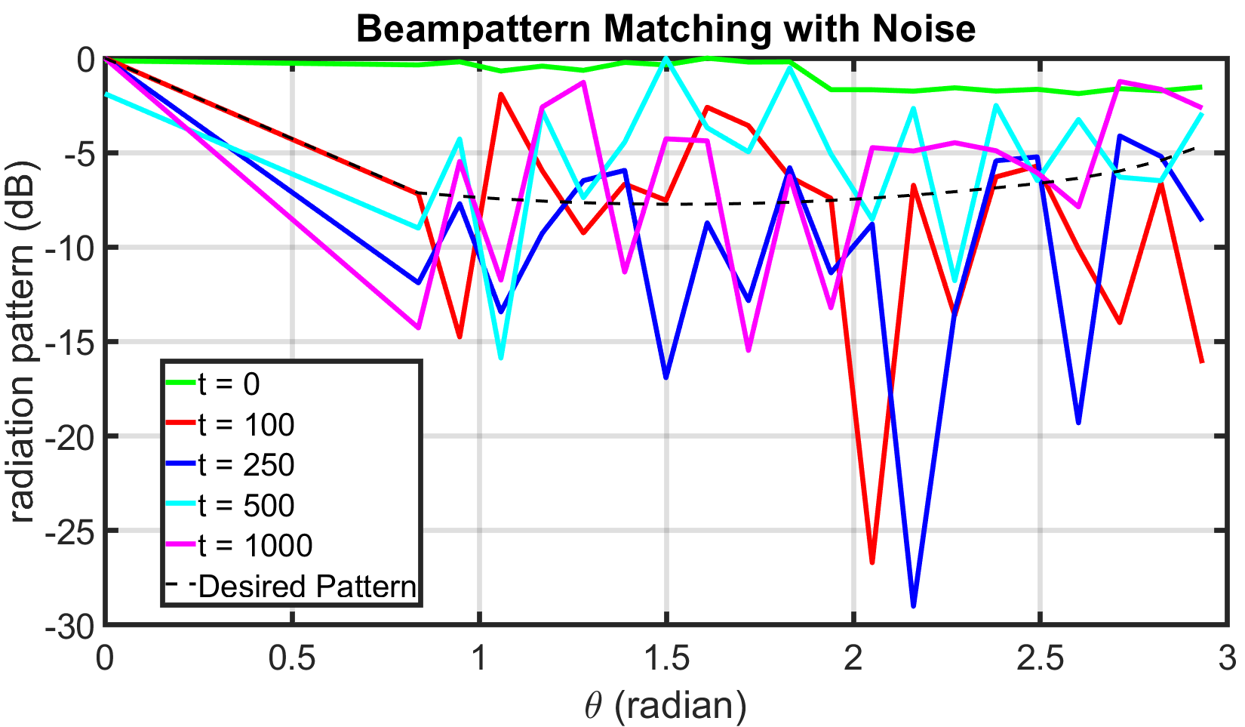
IPG run matching samples from directed beampattern
Replacing flat profile with points from beampattern improves noise robustness

Slide 4
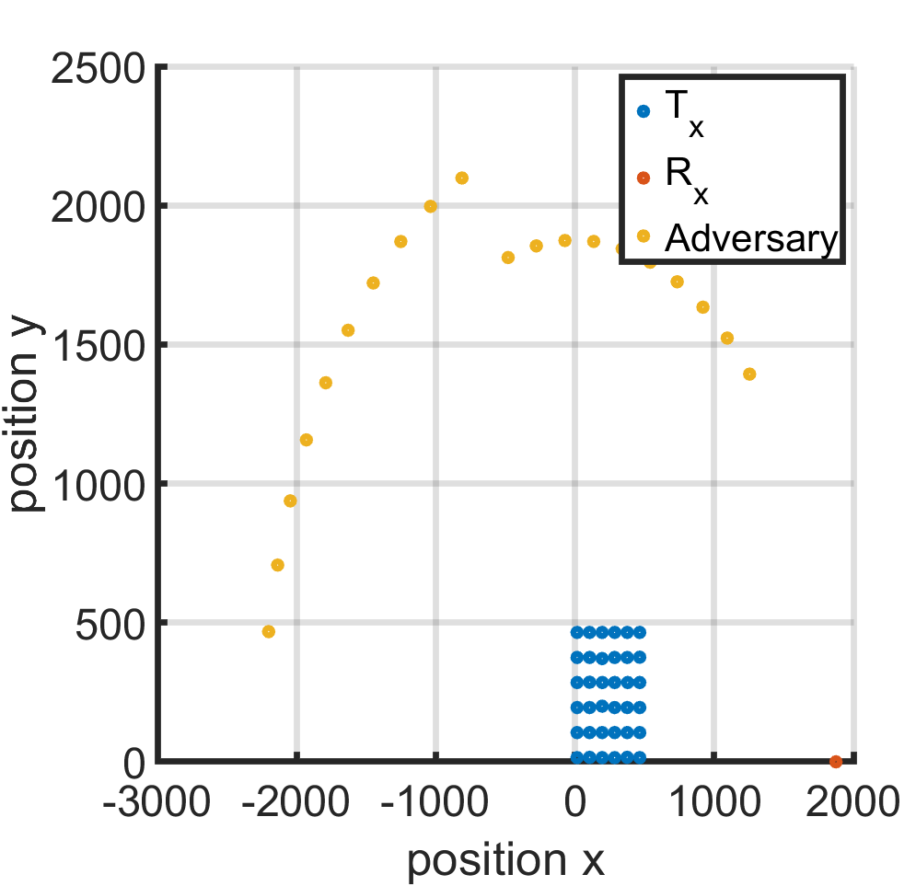
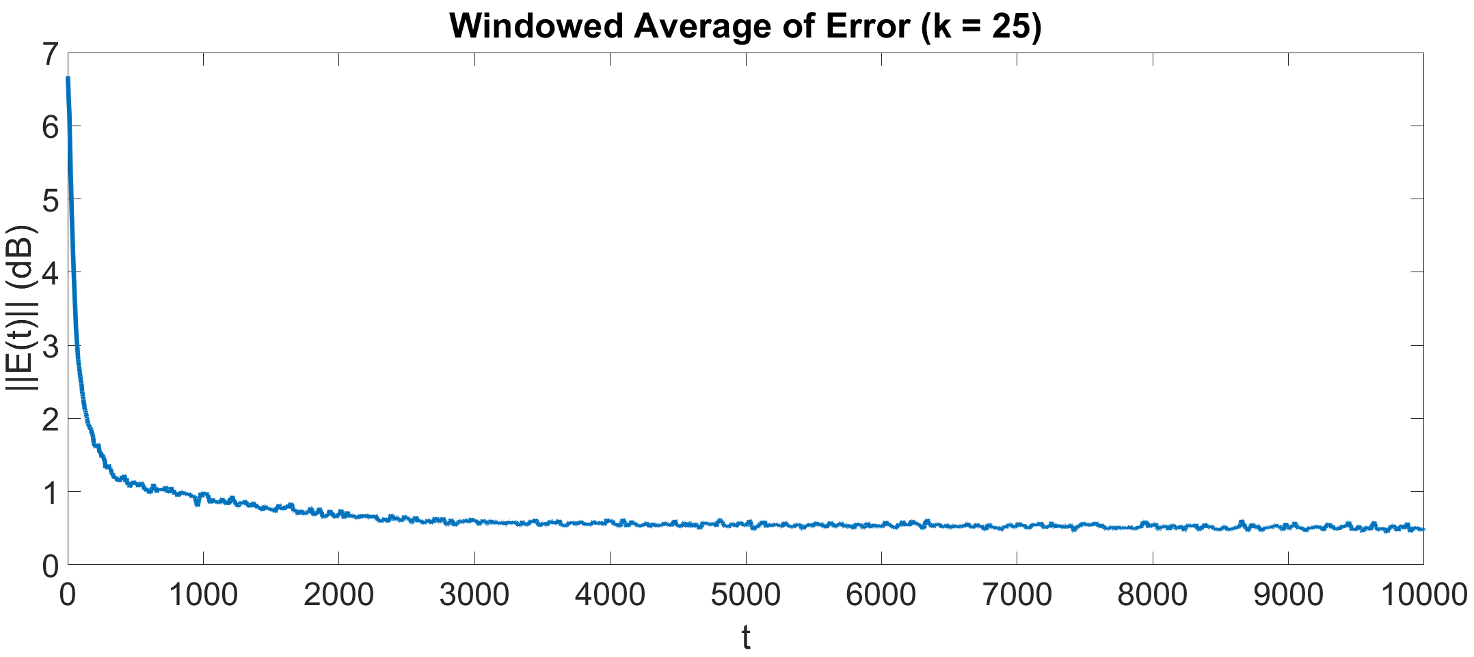
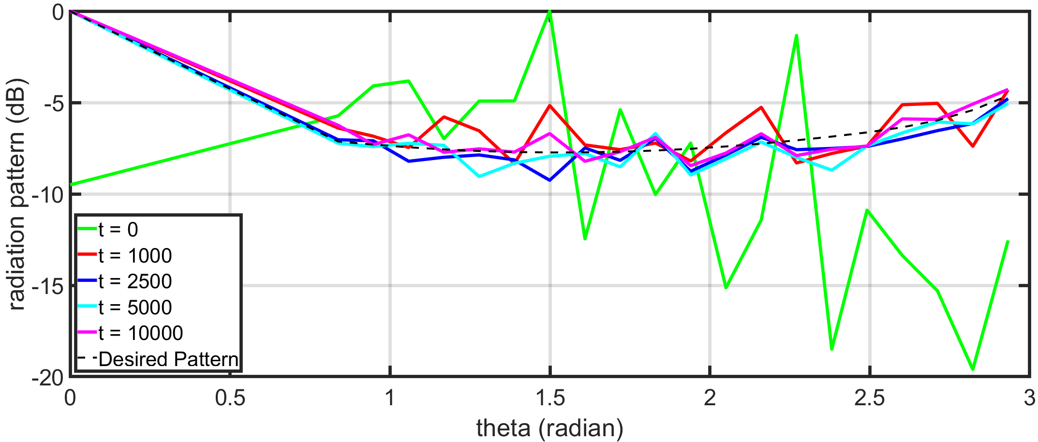
IPG run on 36 node grid (from provided data)

Slide 5
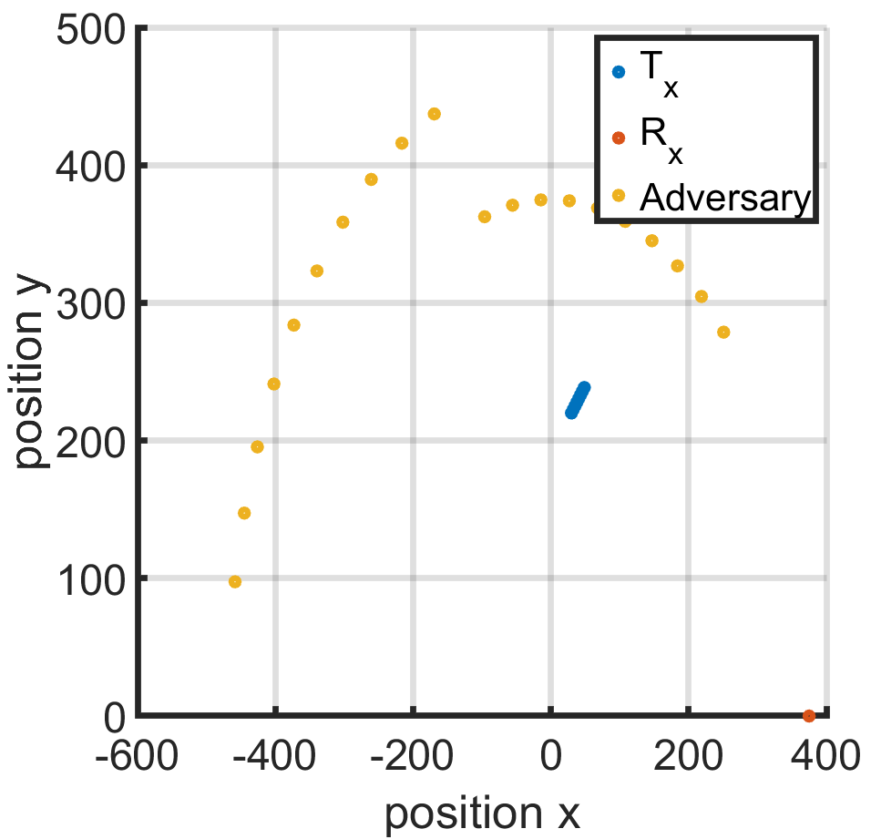
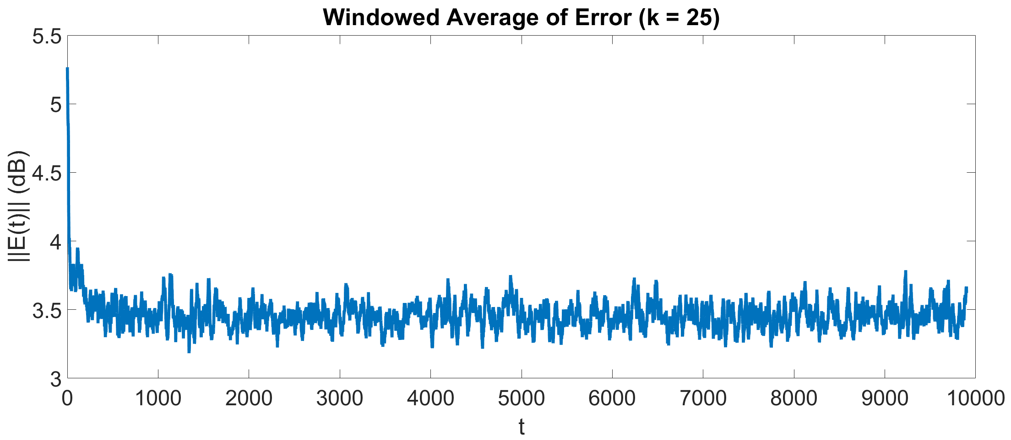
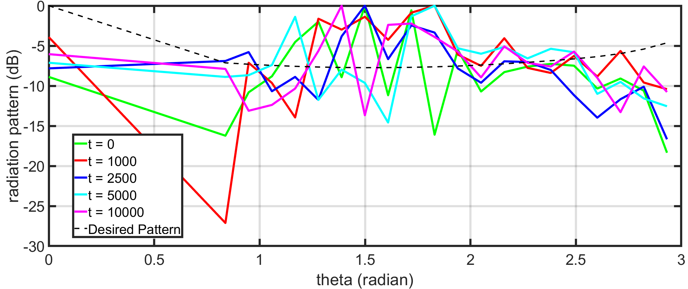
IPG Run with Rx Locations from LA Data (8 Tx)

Slide 6
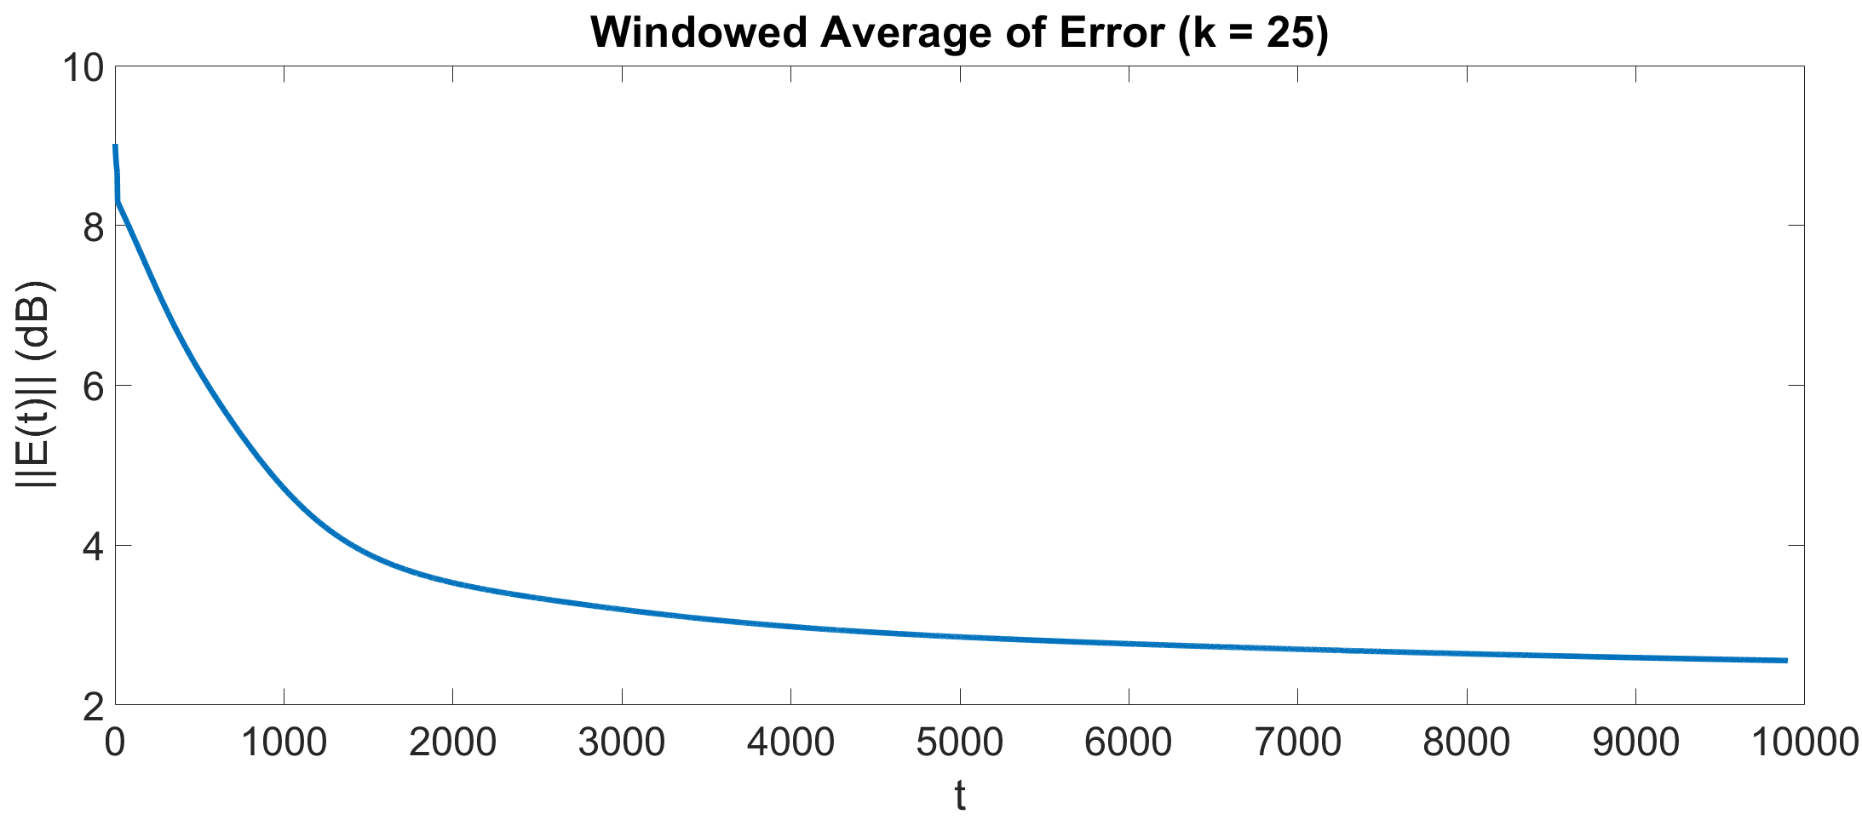
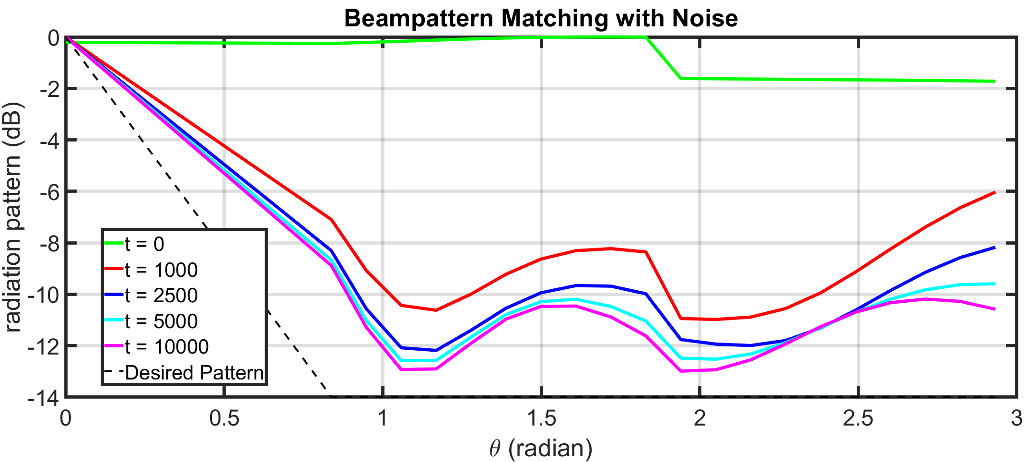
Noiseless Flat Beampattern w/ 22 Tx

Slide 7
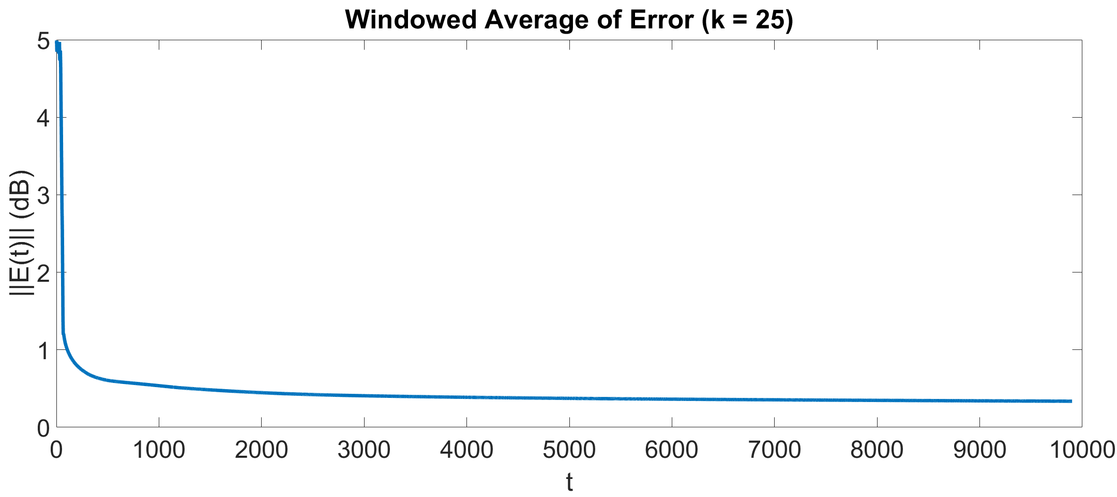
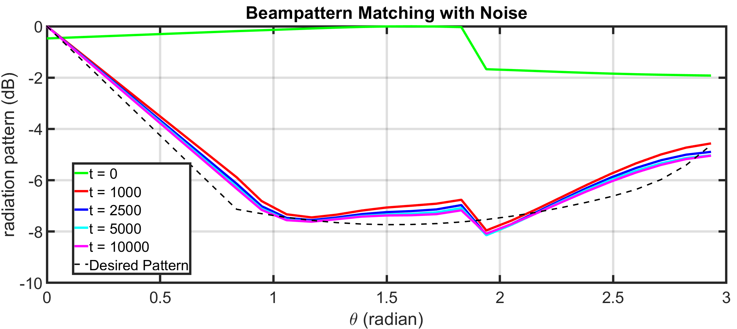
Noiseless Sampled Beampattern w/ 22 Tx

Slide 8
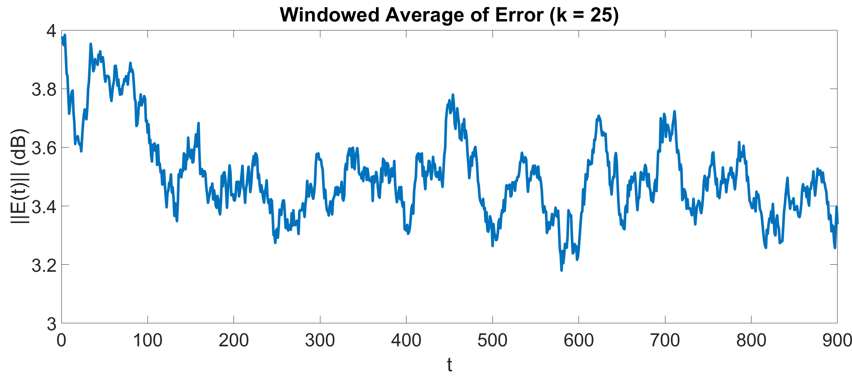
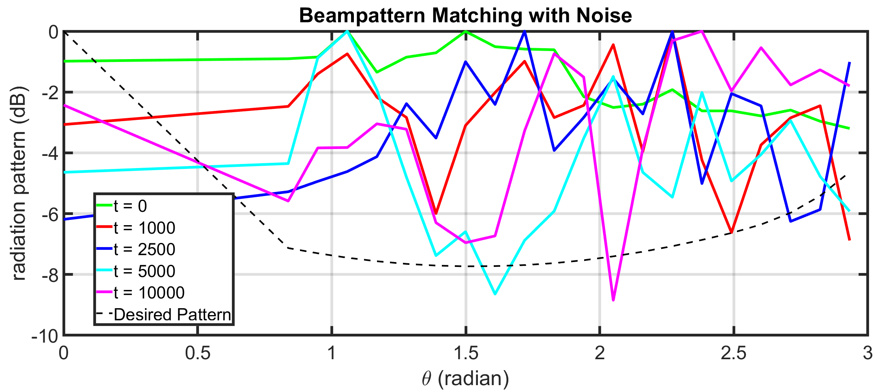
Noisy Sampled Beampattern w/8 Tx

Slide 9
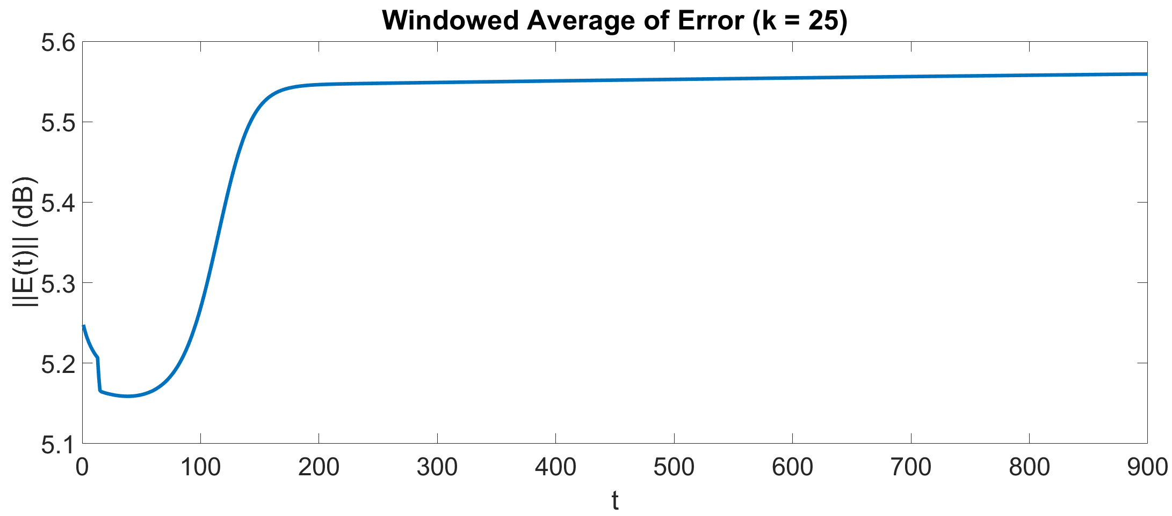
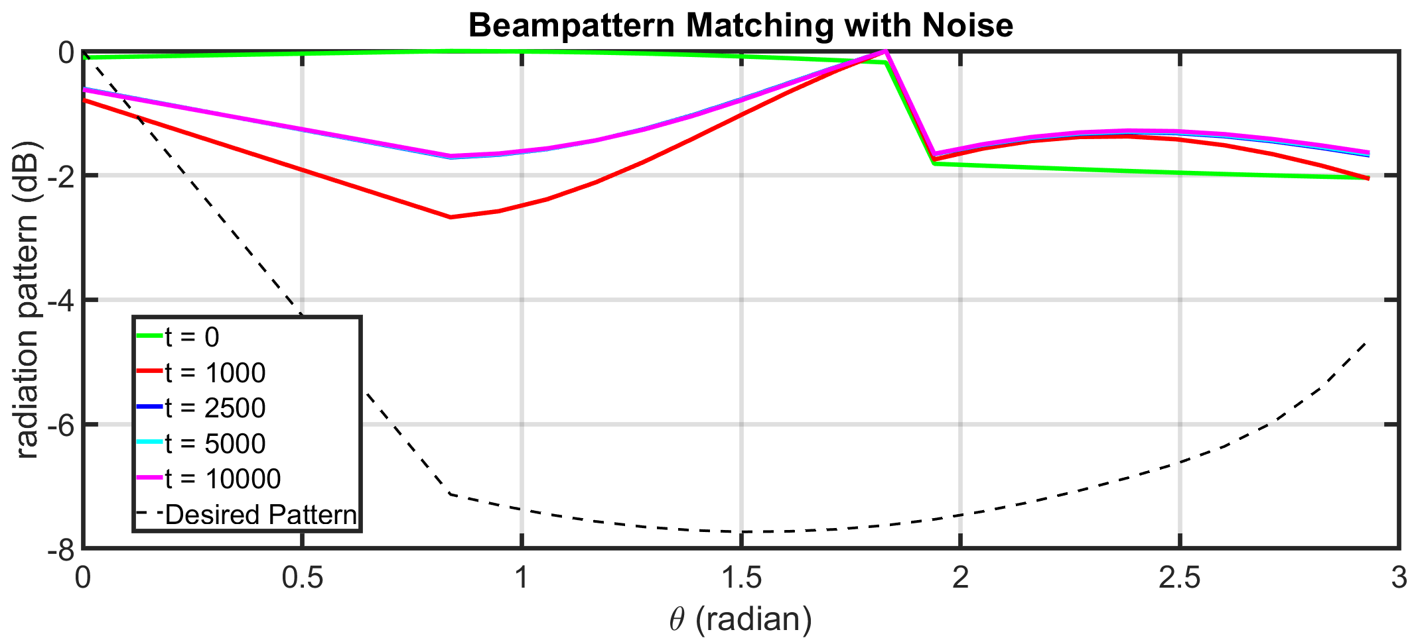
Noiseless Sampled Beampattern w/8 Tx

Slide 10
